Slide 1
Acceptance angle
Numerical Aperture

Slide 2
Acceptance Angle
The maximum angle of incidence at the end face of an Optical fiber for which the light ray can be propagated along Core-Cladding interface is known as Acceptance angle.

Slide 3
Core-Cladding interface
B
θ_{r}
θ
Core n₁
θ_{r}
θi
A
C
Fiber axis
Cladding n₂
Incident light ray

Slide 4
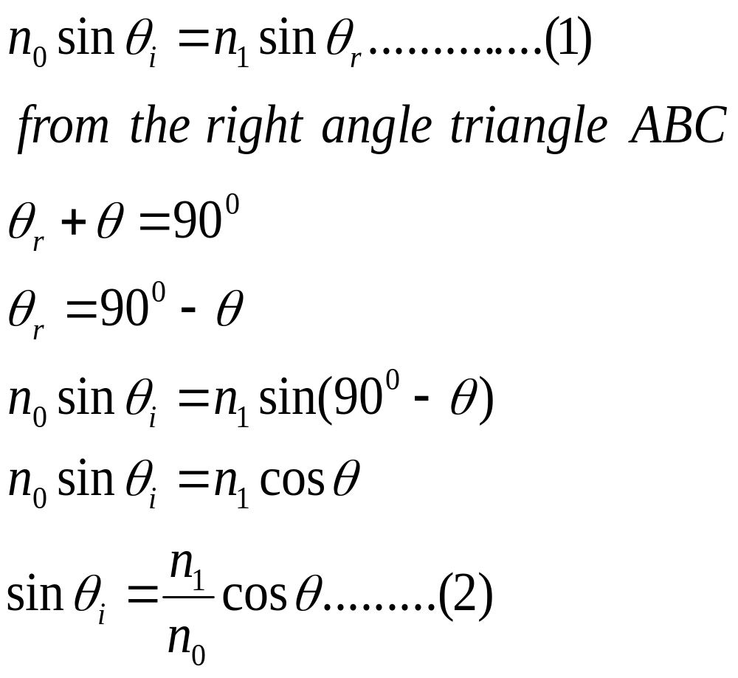
Applying Snell’ s law for Air-Core media

Slide 5
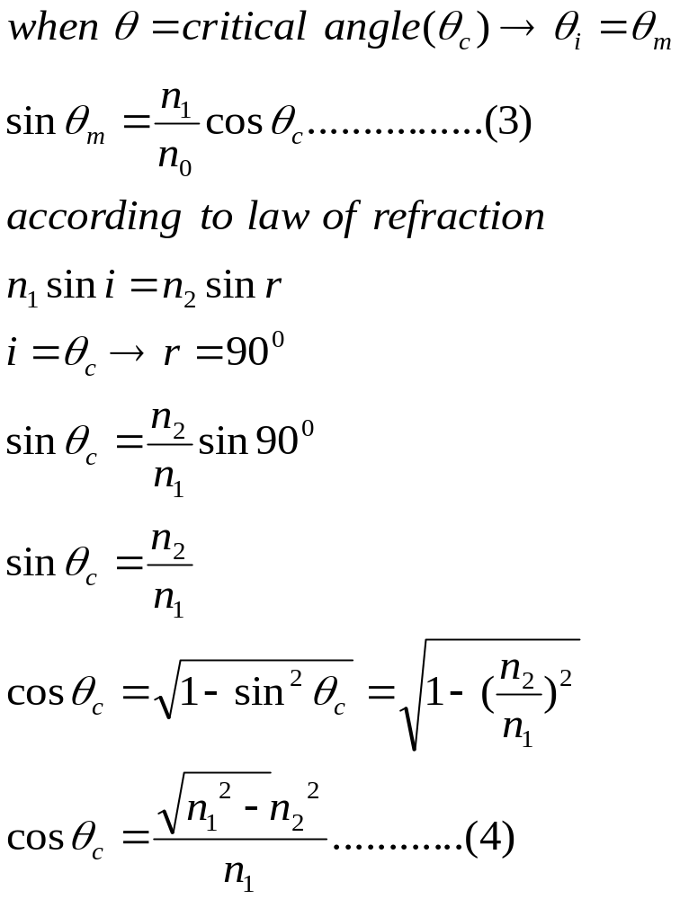

Slide 6
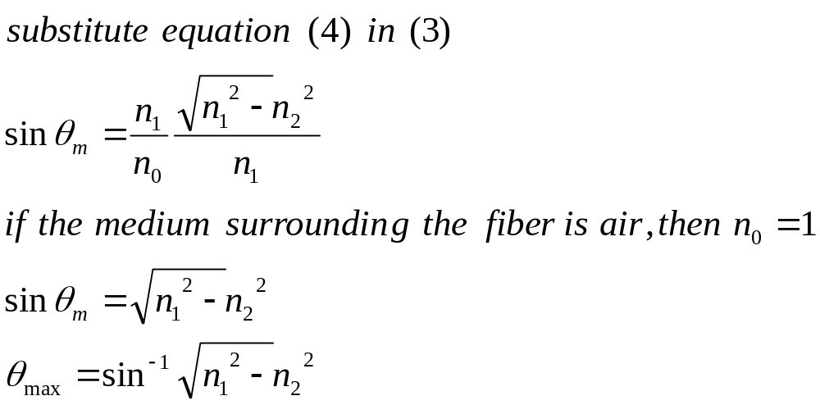
Which is required expression for Acceptance Angle in optical fibers.

Slide 7
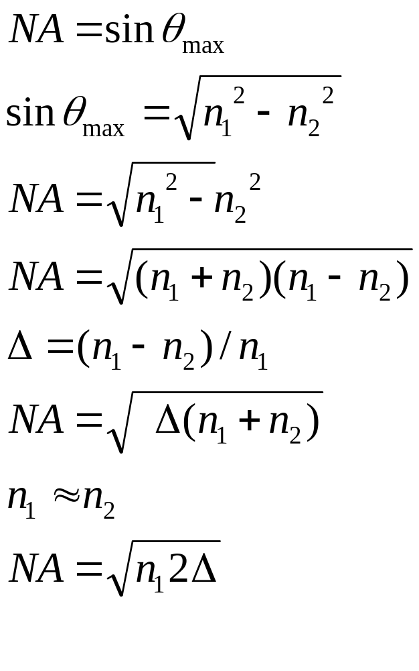
Numerical Aperture
The light gathering capacity of an optical fiber is known as Numerical Aperture and it is proportional to Acceptance Angle.
It is numerically equal to sine of Acceptance Angle.
The ratio between the difference
in RI’s of Core and Cladding to that of RI of
core is called the fractional change.

Slide 8
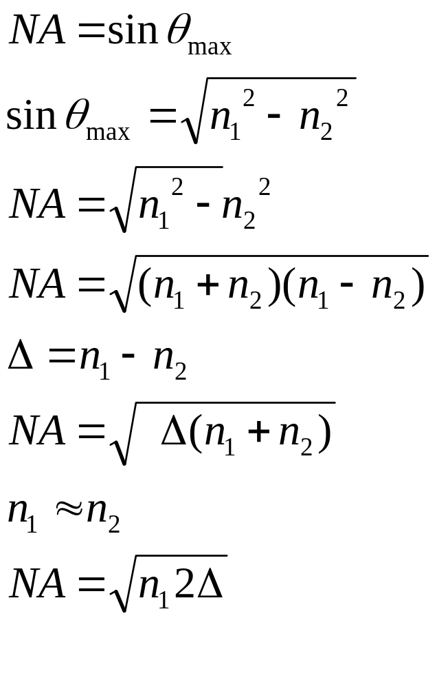
Numerical Aperture
It is the measure of the amount of light that can be accepted by a fiber.
It depends only on Refractive indices of core and cladding and not on fiber dimensions.
It is always <1 and ranges from 0.13 to 0.50.
A larger numerical aperture implies that a fiber will accept a large amount of light from the source.

